Slide 1




TRACK N TONE
HOME
BMI
CALORIE
WORKOUT
TRACK N TONE
"Get On Track, Stay in Tone!"

Slide 2

TRACK N TONE
TEAM MEMBERS
GUNJAN | 2210990332
PRACHI SINGLA | 2210990662
PRATISTHA NEGI | 2210990678
PUNAL | 2210990690

Slide 3

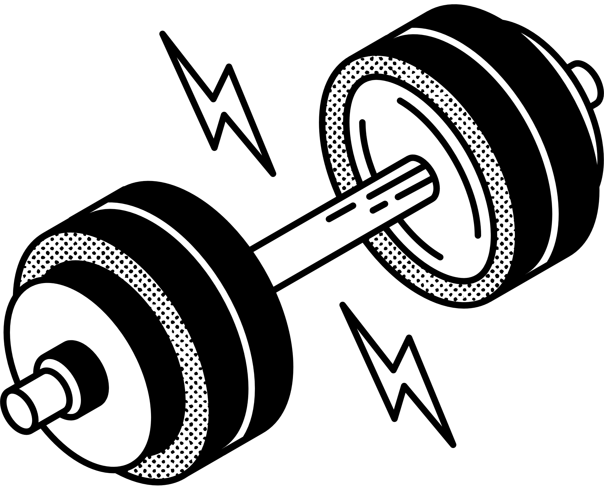
TRACK N TONE
WHAT IS TRACK N TONE?
HOME: THE MAIN DASHBOARD THAT PROVIDES AN OVERVIEW OF THE USER'S FITNESS METRICS AND NAVIGATION TO OTHER SECTIONS.
CALORIE COUNT: A TOOL FOR LOGGING DAILY FOOD INTAKE, TRACKING CONSUMED CALORIES, AND MANAGING DIETARY GOALS.
3. BMI CALCULATOR: CALCULATES THE USER’S BODY MASS INDEX (BMI) BASED ON HEIGHT AND WEIGHT, AND PROVIDES BMI CATEGORY INSIGHTS.
4. RANDOM WORKOUT: GENERATES A VARIETY OF WORKOUT ROUTINES TO HELP USERS STAY MOTIVATED AND TRY NEW EXERCISES.

Slide 4


TRACK N TONE
TRACK N TONE IS NEEDED FOR:
1. COMPREHENSIVE HEALTH TRACKING: INTEGRATES CALORIE COUNTING, BMI CALCULATION, AND WORKOUT ROUTINES IN ONE APP.
2. PERSONALIZED FITNESS: TAILORS FITNESS AND DIETARY GOALS BASED ON USER INPUT.
3. MOTIVATION: OFFERS VARIED WORKOUTS TO KEEP USERS ENGAGED.
4. CONVENIENCE: SIMPLIFIES HEALTH MANAGEMENT BY COMBINING MULTIPLE TOOLS INTO ONE PLATFORM.
WHY IT IS REQUIRED?

Slide 5

TRACK N TONE
HOME
BMI
CALORIE
WORKOUT
STORES THE BMI RECORDS AND ALLOWS QUERYING OR DELETING DATA WHEN REQUESTED.
EXPRESS.JS
RECEIVES API REQUESTS FROM REACT, AND FORWARDS THEM TO THE NODE.JS CONTROLLER FOR HANDLING.
SENDS BACK THE RESULTS OF THE DATABASE OPERATIONS
MONGO DB
TOOLS USED
MERN BASED
REACT.JS
THE CONTROLLER LOGIC THAT PROCESSES THE REQUESTS FROM EXPRESS.
INTERACTS WITH MONGODB FOR DATA STORAGE/RETRIEVAL AND HANDLES BUSINESS LOGIC.
SENDS API REQUESTS TO THE BACK-END (EXPRESS) TO PERFORM CRUD OPERATIONS (E.G., CALCULATING BMI, STORING/RETRIEVING RECORDS).
Receives data from the API to update the UI (BMI display, records list).
NODE.JS

Slide 6
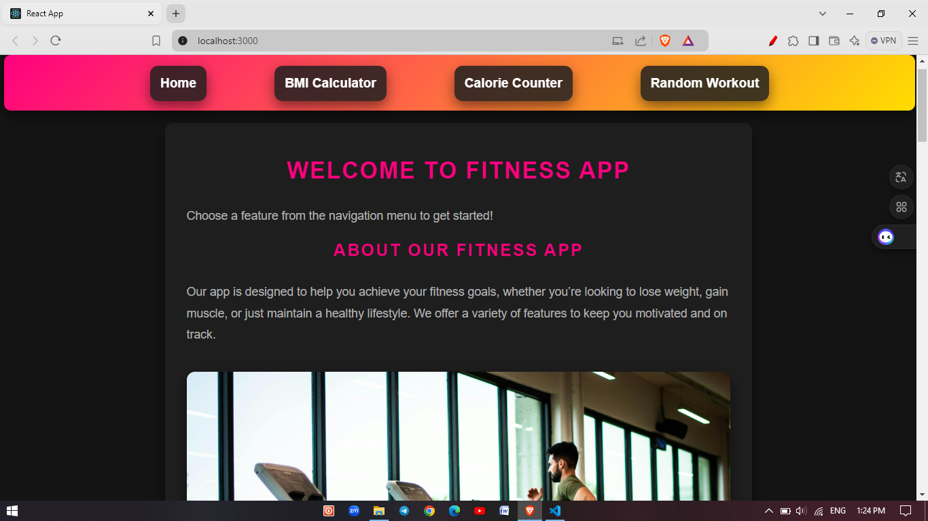

Slide 7
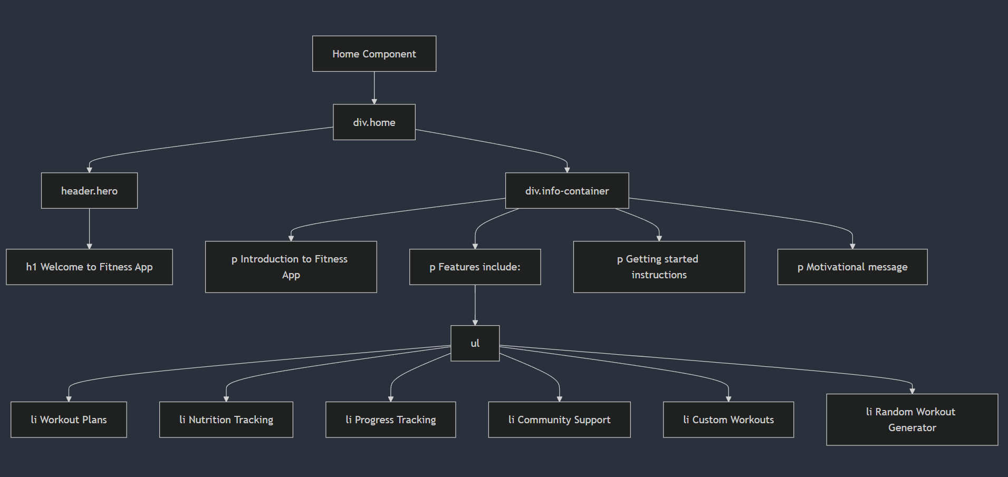
HOME PAGE
TRACK N TONE

Slide 8
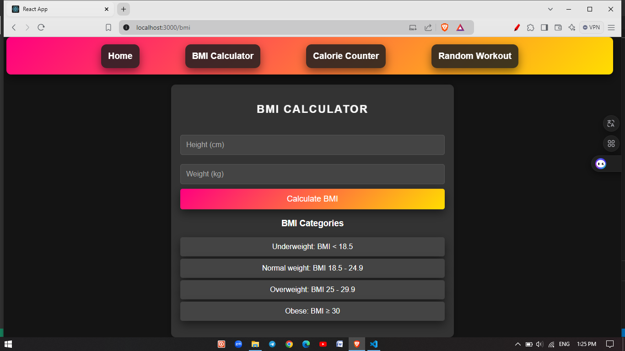

Slide 9
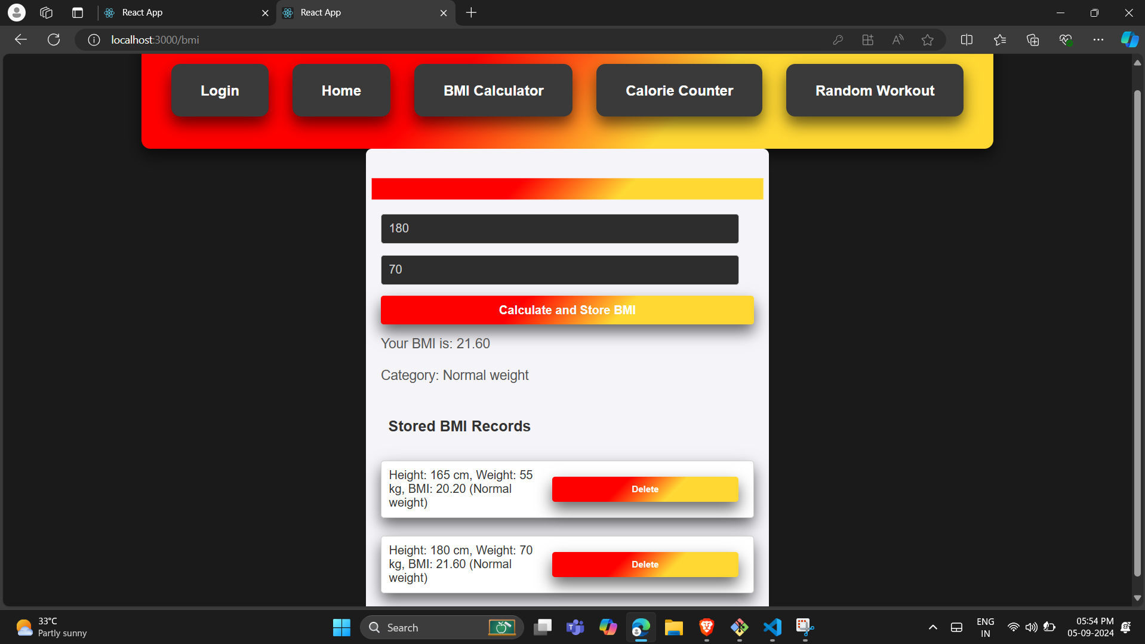

Slide 10
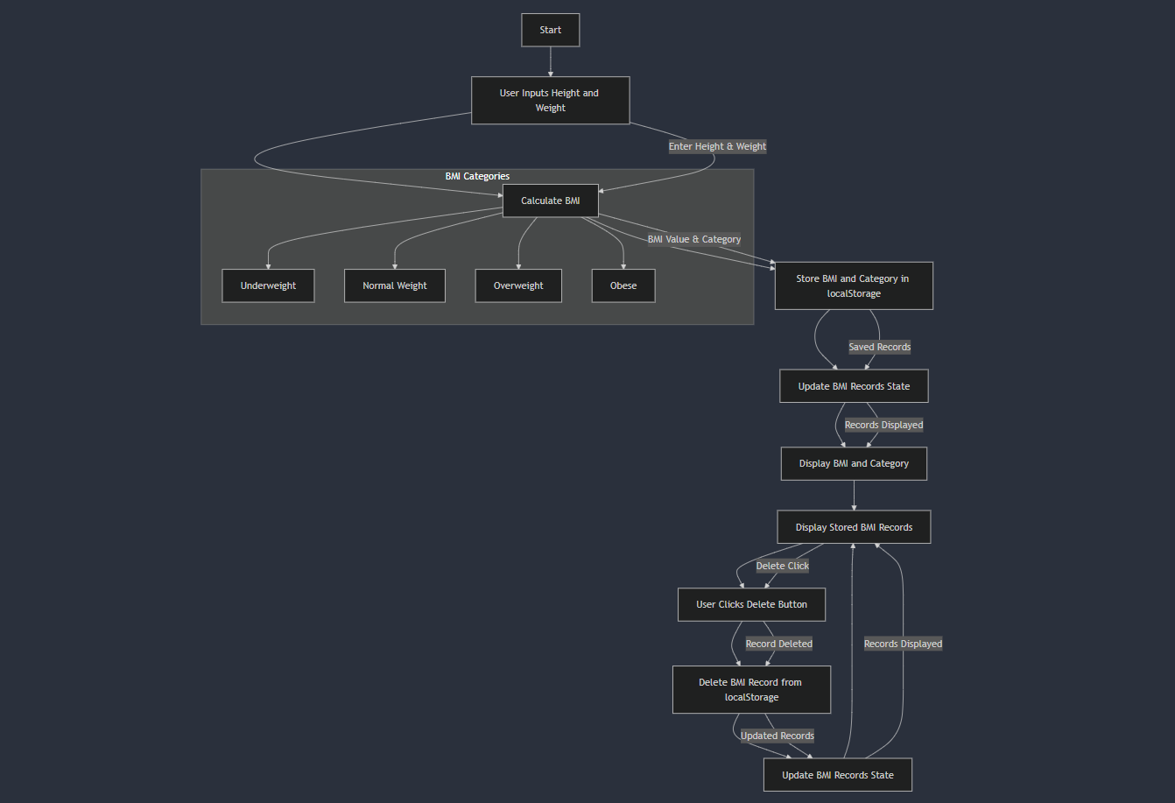
BMI

Slide 11
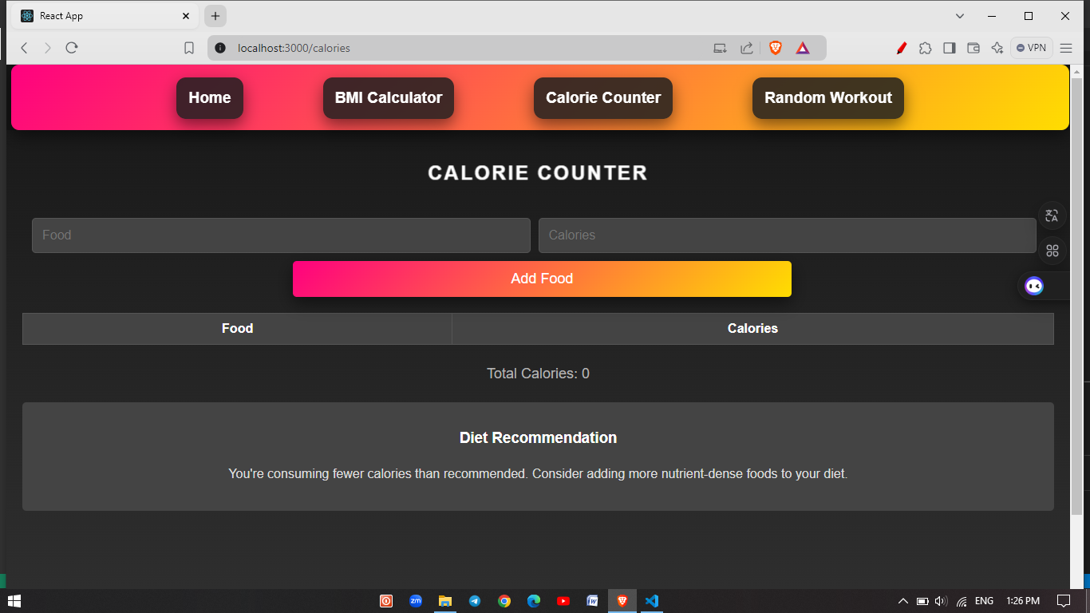

Slide 12
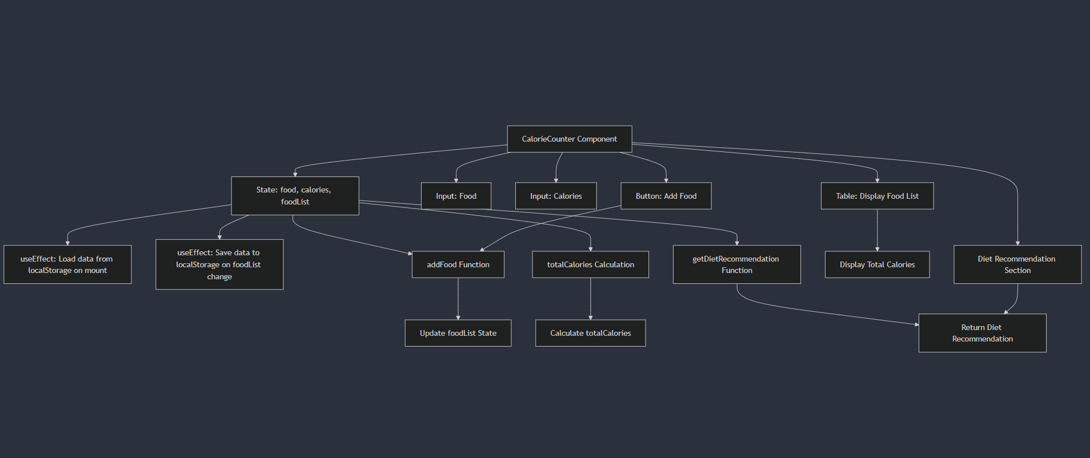
CALORIE

Slide 13
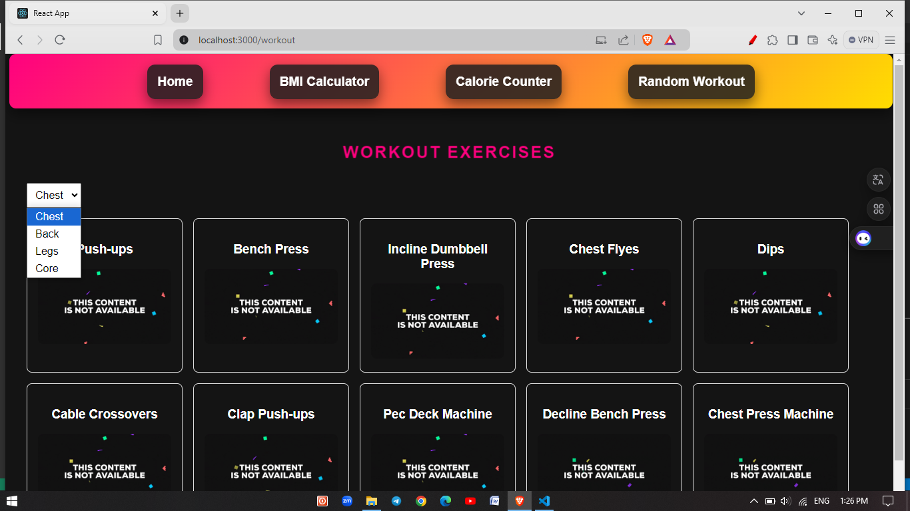

Slide 14
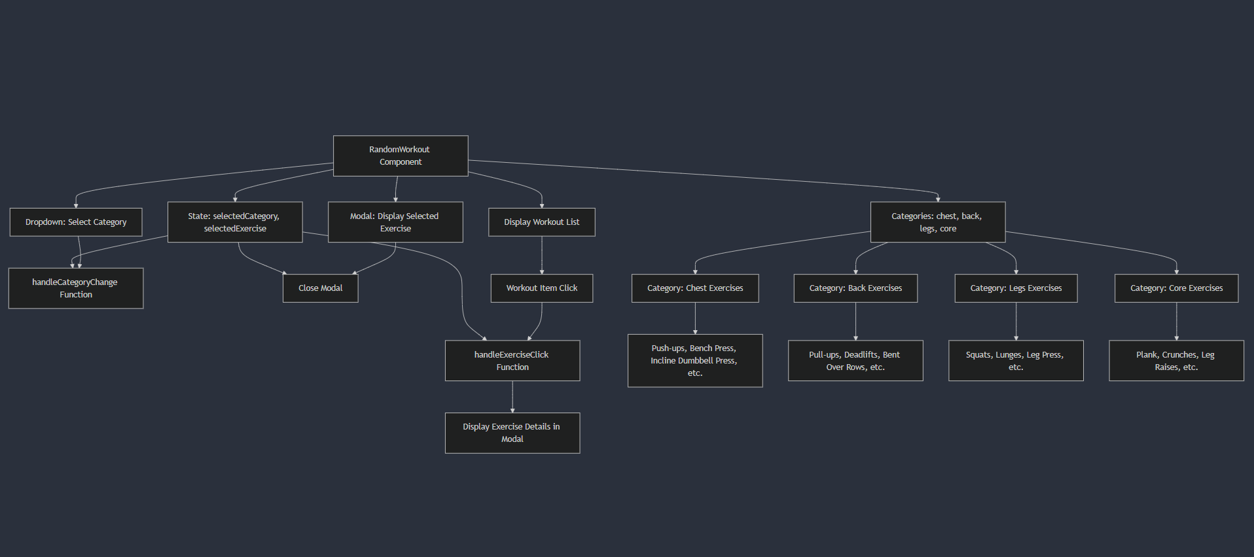
WORKOUT

Slide 15


TRACK N TONE
SIMPLIFY YOUR HEALTH JOURNEY WITH INTEGRATED TOOLS FOR CALORIE COUNTING, BMI TRACKING, AND PERSONALIZED WORKOUTS.
"Track n Tone:
Your Ultimate Fitness Companion"

Slide 16

TRACK N TONE
THANK YOU

